Slide 1

Time Table Management System
Team Members Details
Mr. A. Joseph paul – 22N35A6201
Ms. S.Ramya – 21N316256
Mr. M. ManiSagar Yadav – 21N31A6243
III Year B.Tech – CSE (Cyber Security)
Under the Guidance of
Dr.Dileep
Professor & Dept. of ET
B.Tech III Year – I Sem | Application Development – 1 | External Project Review

Slide 2
Abstract
Brief / overview about your proposal in point-wise-point
manually by writing over the data
Again, there is a high probability of getting drawn into an error like clash among the classes or having two particular classes in the same classroom or with the same faculty having more than one lecture at a particular time
Just to overcome such issues we propose a automated system which comes with precision, accuracy and ease.

Slide 3
Introduction
The main factor in running any academy or college is the need for a well - planned and clash- free timetable
timetable construction is also a very difficult problem while construction we have to think about the lot of constrains which is difficult.
some constrains which are common by considering this constrains time Tabling construction by using python/Java becomes easy

Slide 4
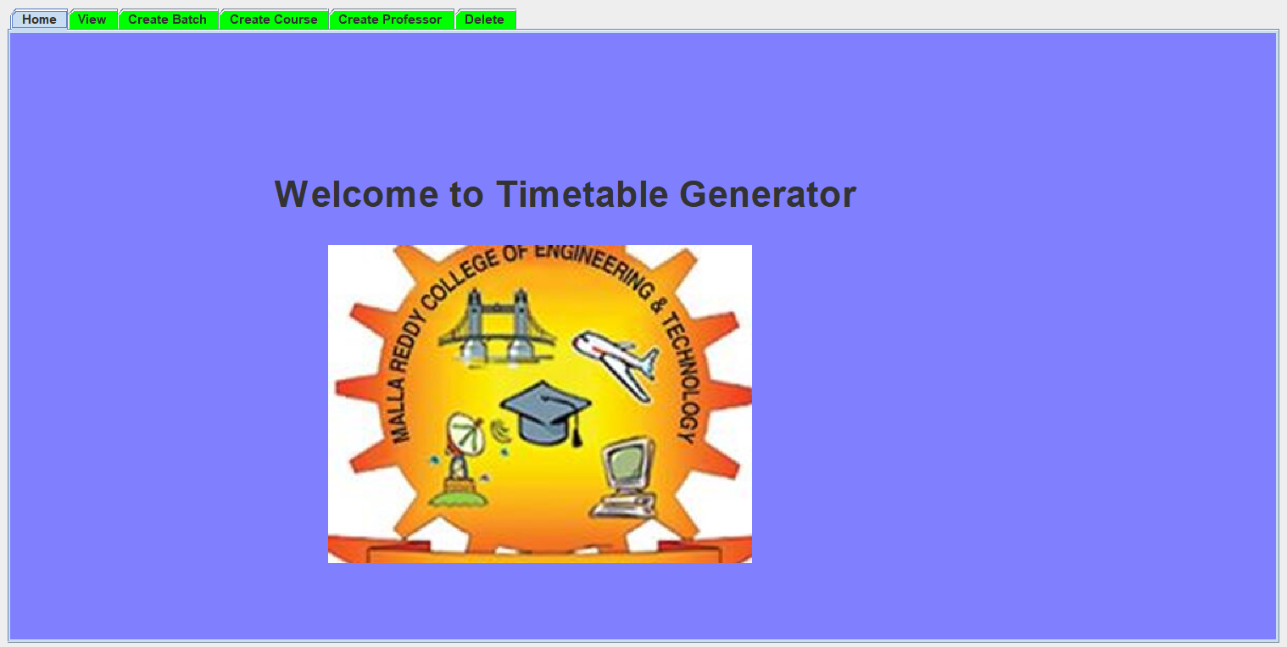
Existing System
Structure of Existing System (If Existing System is available)
The existed System has:
adding of faculty and students
Manual modification of time table
Admin access
Used Java AWT

Slide 5
Proposed System
The proposed System has:
Addition , Updation , Deletion of Faculty and Students
Genetic Algorithm is used for Automatic timetable generation
Better Graphical Representation

Slide 6
Architecture Diagram or System Diagram

Slide 7
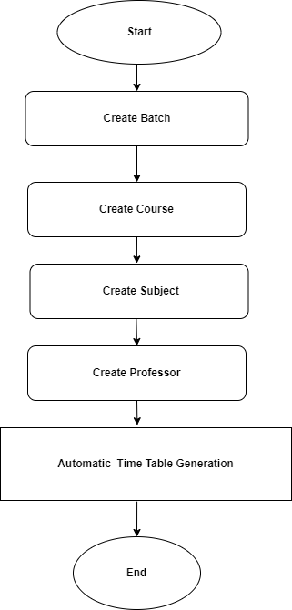
System Architecture

Slide 8
Software Requirements Specification (SRS)

Slide 9
Software Requirement Specifications (SRS)
List all the Software used for development of the application which includes, front-end and back-end software(s) etc.
Programming : Java Programming
GUI: Java AWT

Slide 10
Hardware Requirement Specifications (HRS)
Operating System: Can Run on Windows any version
Ram : Minimum 8GB is Required
Graphic Card:

Slide 11
Application Modules
List out how many modules that the project is divided for development and mention the name of the module
Example:
Module -1 : Home Screen
Module -2: View Module
Module -3: Create Batch
Module-4: Create Course
Module-5: Create Professor and Delete

Slide 12
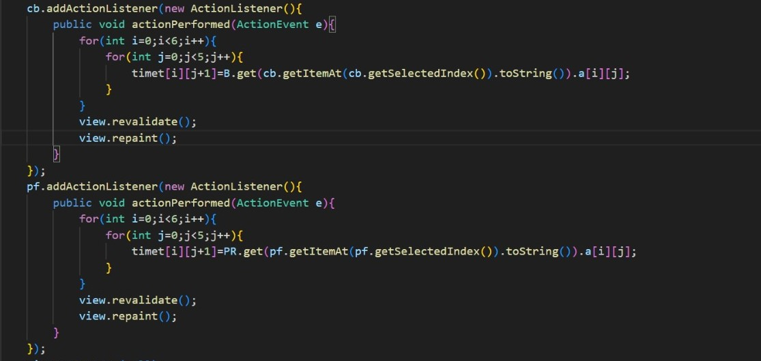
Implementation
.

Slide 13
System Models (UML Diagrams)

Slide 14
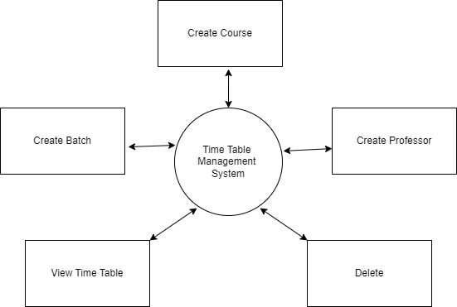
Dataflow Diagram

Slide 15
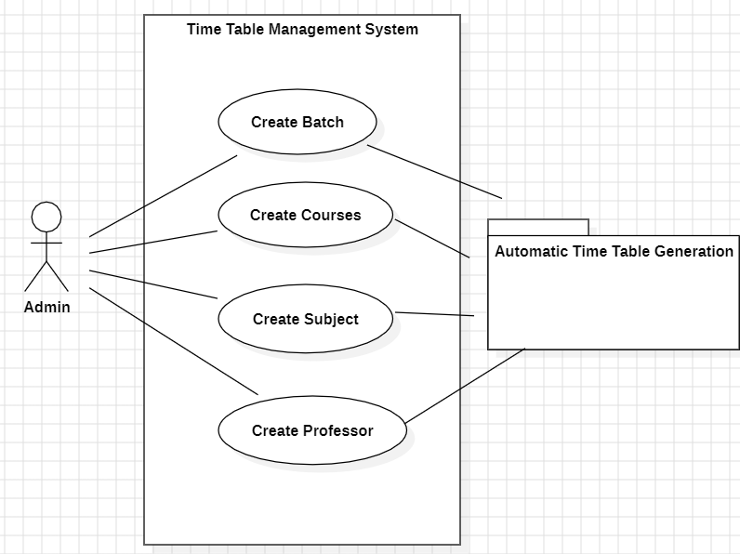
Use-Case Diagram

Slide 16
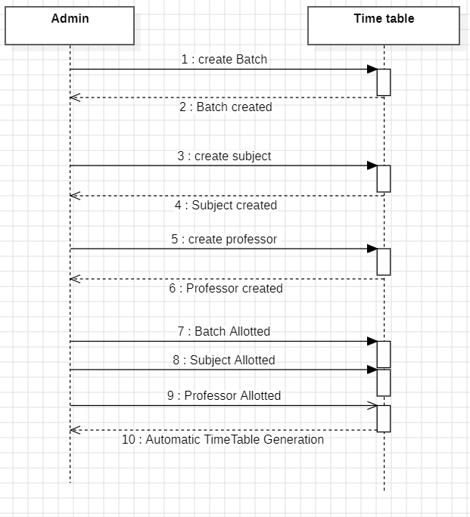
Sequential Diagram

Slide 17
Output Screens

Slide 18
Results (Output Screens)
Home Screen:

Slide 19
Application Testing

Slide 20
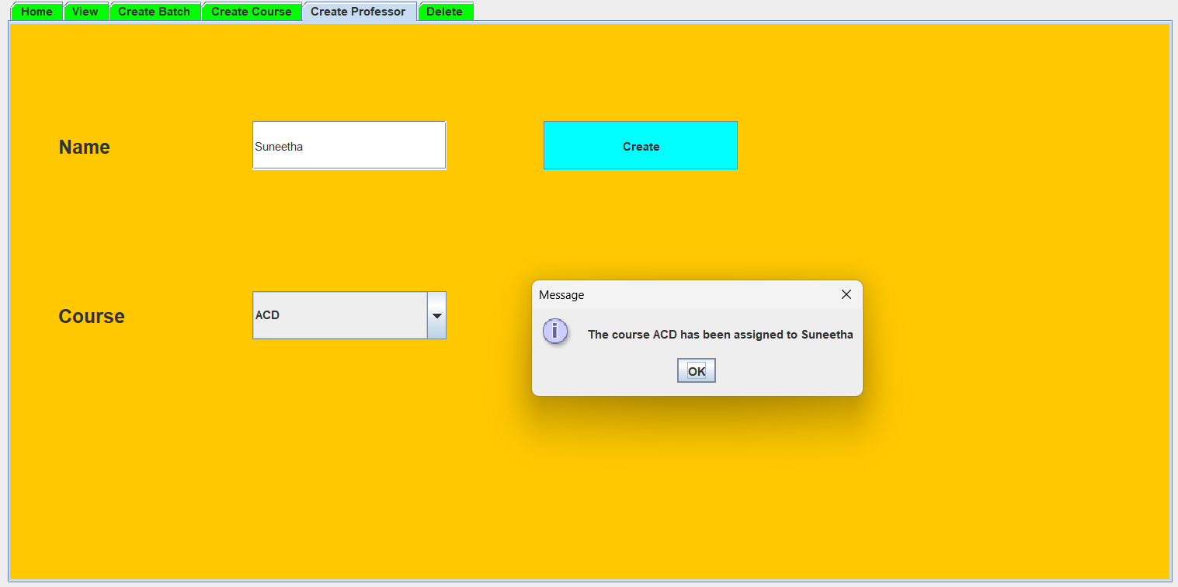
Test Cases (If you have conducted Testing)
Create Professor:

Slide 21
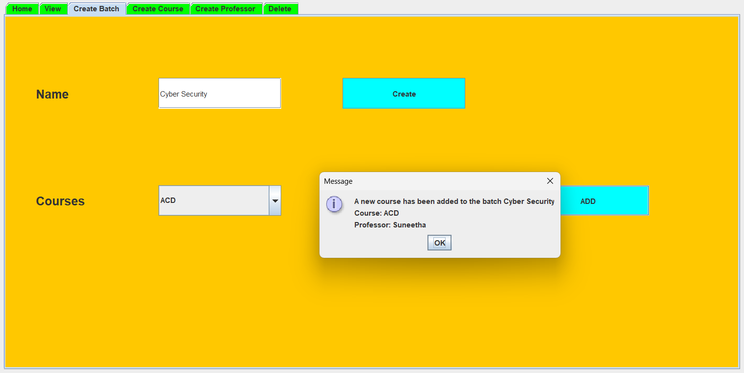
Test Cases (If you have conducted Testing)
Create Batch:

Slide 22
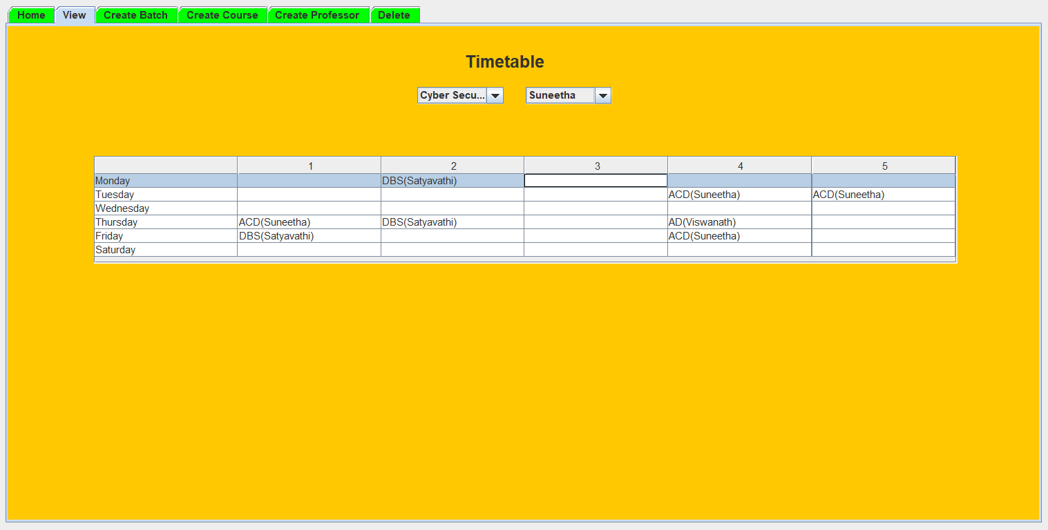
Test Cases (If you have conducted Testing)
View Screen:

Slide 23
Conclusion & Future Scope

Slide 24
Conclusion
ATMS efficiently organizes schedules , enhances productivity , and minimizes conflicts
User-friendly
Simplify the scheduling process
Automated features

Slide 25
Future Scope
1. Semantic Understanding:
2. User-Friendly Interfaces:
3. Mobile Accessibility:
4. Collaboration Features:
5. Continuous Improvement

Slide 26
Thank you
Mr. A. Joseph paul – 22N35A6201
Mrs. S.Ramya – 21N316256
Mr. M. ManiSagar Yadav – 21N31A6243

